Slide 1
Panel Discussion
Retailer Optimization:
In-store Marketing and Merchandising
Tom Delacenserie, Secretary
April 7, 2016

Slide 2
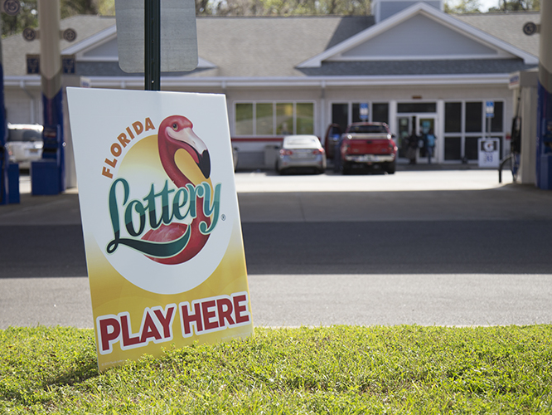
IMPROVING PRODUCT AWARENESS

Slide 3
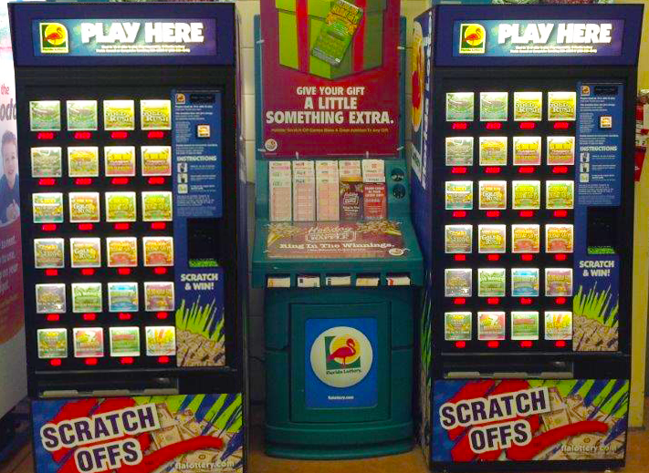
MERCHANDISING
THE PRODUCT

Slide 4
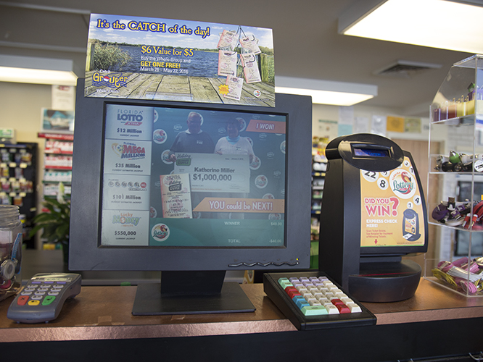
POINT OF SALE/
POINT OF PURCHASE SIGNAGE

Slide 5


Slide 6
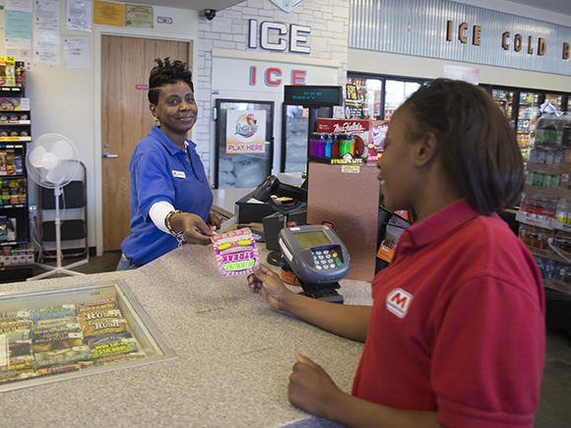
CONNECTING WITH
THE CONSUMER

Slide 7
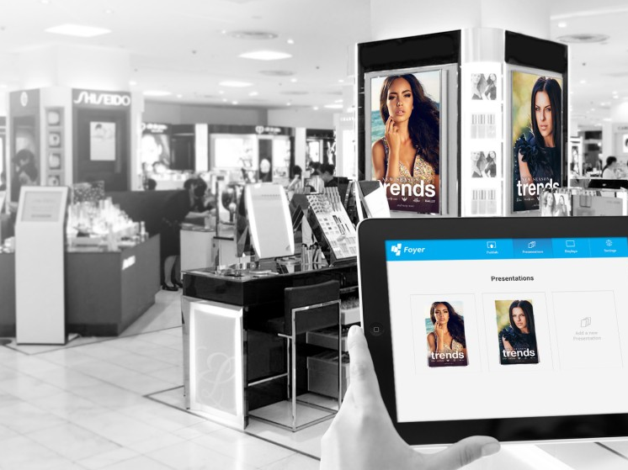
LOOKING TOWARD
THE FUTURE

